Slide 1
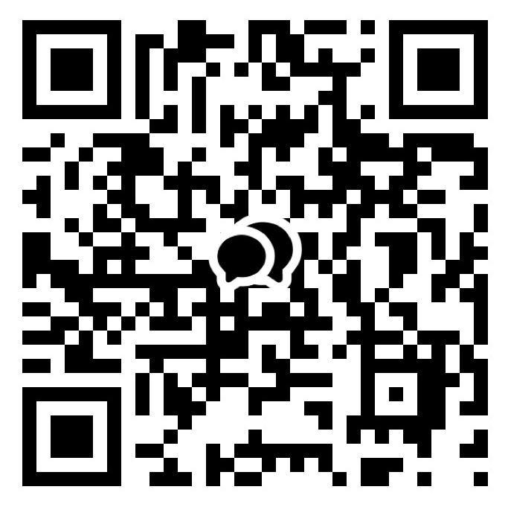



ANNOUNCEMENT
Welcome
1. LIFE GROUP!
If you are not in one, please let us know.
2. Bible Study
Hebrews & Genesis: Please sign up.
3. New Group Chat
Please sign into our new group chat
as being a part of the community.
4. Kids CEM summer VBS(Vacation Bible School)
Title : Rainforest Falls (Wow! God!)
When : 7/31 - 8/2 (Fri - Sun)
Where : The Shim(더쉼) Retreat Center
*Prayers are most needed!
(Praise God! Volunteers are filled!)
CHOONGJUNG CHURCH
KAKAO GROUP CHAT
CHOONGJUNG
ENGLISH
MINISTRY
KIDS 09:30 AM for Elementary Students
LIFE 11:30 AM for Youth & Adults
SUNDAY BULLETIN
PASTOR & STAFF
JULY 19, 2026
PASTOR | Daniel Chung(정다니엘 목사) 010-8101-0940 Yaqub Kashif(야곱 목사) 010-5897-2490
DIRECTOR | LIFE Elder Paul Jeong(정희대 장로) 010-3911-1586 KIDS Deacon Spencer Hwang(황규문 집사) 010-2304-6267
ASST DIRECTOR | Deacon Ebraim Shin(신승환 집사) 010-2304-6267
PRAISE TEAM : NUEVOS SCRIPTURE READING TEAM : VOICE OF LIFE
2026 CHURCH VISION
2026 CEM VISION : REACTION
EVEN THERE YOUR HAND WILL GUIDE ME,
YOUR RIGHT HAND WILL HOLD ME FAST.
WE PROCLAIM TO YOU
WHAT WE HAVE SEEN AND HEARD
SO THAT YOU ALSO
MAY HAVE FELLOWSHIP WITH US ...
PSALMS 139:10
1 JOHN 1:3

Slide 2


ORDER OF SERVICE
SERMON NOTES
PRAISE | NUEVOS
PRAYER | Sister Sandy Kim
GREETING | God is with us.
ANNOUNCEMENT & WELCOME NEWCOMERS
SCRIPTURE | Exodus 25:8-9
SERMON | THE TABERNACLE WAS BUILT REV. DANIEL CHUNG
PRAYER
OFFERING | “complete”
BENEDICTION
LIFE GROUP
LIFE GROUP QUESTIONS
1 | How does knowing that God came to dwell with us change the way you see your relationship with Him? // 하나님께서 우리와 함께 거하시기 위해 오셨다는 사실은 하나님과의 관계를 어떻게 바라보게 하나요?
2 | What keeps you from enjoying God's presence even though Jesus has opened the way? // 예수님께서 하나님께 나아가는 길을 열어 주셨는데도, 하나님의 임재를 누리지 못하게 하는 것은 무엇인가요?
3 | What is one step you can take this week to draw closer to God instead of simply knowing about Him? // 이번 주에 하나님에 대해 아는 것을 넘어, 하나님께 더 가까이 나아가기 위해 실천할 수 있는 한 가지는 무엇인가요?
KAKAO GROUP CHAT
www.ilsanenglishworship.org @ilsanenglishworshipcem
3F, 244, Ilsan-ro, Ilsandong-gu, Goyang-si, Gyeonggi-do, Korea, 10417

