Slide 1
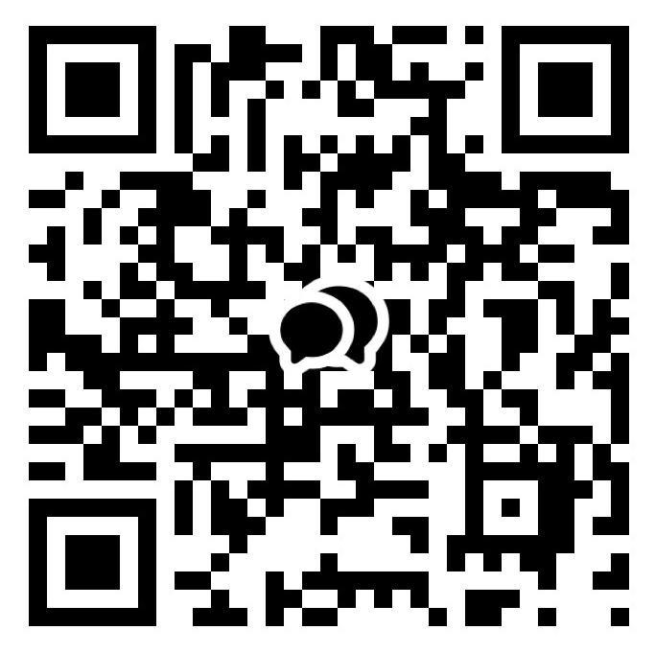



ANNOUNCEMENT
Welcome
1. LIFE GROUP!
If you are not in one, please let us know.
2. Bible Study
Hebrews & Genesis: Please sign up.
3. New Group Chat
Please sign into our new group chat
as being a part of the community.
4. Kids CEM summer VBS(Vacation Bible School)
Title : Rainforest Falls (Wow! God!)
When : 7/31 - 8/2 (Fri - Sun)
Where : The Shim(더쉼) Retreat Center
*Prayers are most needed!
(Praise God! Volunteers are filled!)
CHOONGJUNG CHURCH
KAKAO GROUP CHAT
CHOONGJUNG
ENGLISH
MINISTRY
KIDS 09:30 AM for Elementary Students
LIFE 11:30 AM for Youth & Adults
SUNDAY BULLETIN
PASTOR & STAFF
JULY 12, 2026
PASTOR | Daniel Chung(정다니엘 목사) 010-8101-0940 Yaqub Kashif(야곱 목사) 010-5897-2490
DIRECTOR | LIFE Elder Paul Jeong(정희대 장로) 010-3911-1586 KIDS Deacon Spencer Hwang(황규문 집사) 010-2304-6267
ASST DIRECTOR | Deacon Ebraim Shin(신승환 집사) 010-2304-6267
PRAISE TEAM : NUEVOS SCRIPTURE READING TEAM : VOICE OF LIFE
2026 CHURCH VISION
2026 CEM VISION : REACTION
EVEN THERE YOUR HAND WILL GUIDE ME,
YOUR RIGHT HAND WILL HOLD ME FAST.
WE PROCLAIM TO YOU
WHAT WE HAVE SEEN AND HEARD
SO THAT YOU ALSO
MAY HAVE FELLOWSHIP WITH US ...
PSALMS 139:10
1 JOHN 1:3

Slide 2


ORDER OF SERVICE
SERMON NOTES
PRAISE | NUEVOS
PRAYER | Brother Roger
GREETING | God loved us first. Let us love one another.
ANNOUNCEMENT & WELCOME NEWCOMERS
SCRIPTURE | Exodus 20:1-3
SERMON | THE TEN COMMANDMENTS : LOVE OTHERS REV. YAQUB KASHIF
PRAYER
OFFERING | “complete”
BENEDICTION
LIFE GROUP
LIFE GROUP QUESTIONS
1 | The first commandment calls us to give God first place. What most often competes with God for the throne of your heart? // 첫 번째 계명은 하나님을 우리 삶의 가장 첫자리에 모시라고 말씀합니다. 당신의 마음에서 하나님과 가장 자주 경쟁하는 것은 무엇인가요?
2 | God revealed His grace before He gave His commands. How does knowing that God loved and rescued you first change the way you obey Him? // 하나님은 명령을 주시기 전에 먼저 은혜를 보여 주셨습니다. 하나님께서 먼저 당신을 사랑하시고 구원하셨다는 사실은 당신의 순종을 어떻게 변화시키나요?
3 | Jesus fulfilled the Law and showed us perfect love. How can you love God and show His love to others more intentionally this week? // 예수님은 율법을 완성하시고 완전한 사랑을 보여 주셨습니다. 이번 주에 어떻게 하나님을 더 사랑하고 그분의 사랑을 다른 사람들에게 실천할 수 있을까요?
KAKAO GROUP CHAT
www.ilsanenglishworship.org @ilsanenglishworshipcem
3F, 244, Ilsan-ro, Ilsandong-gu, Goyang-si, Gyeonggi-do, Korea, 10417

