Slide 1
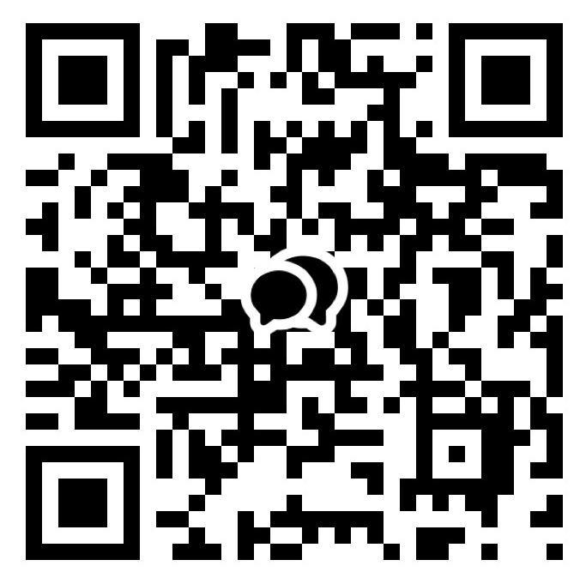



ANNOUNCEMENT
Welcome
1. LIFE GROUP!
If you are not in one, please let us know.
2. Bible Study
Hebrews & Genesis: Please sign up.
3. New Group Chat
Please sign into our new group chat
as being a part of the community.
4. Kids CEM summer VBS(Vacation Bible School)
Title : Rainforest Falls (Wow! God!)
When : 7/31 - 8/2 (Fri - Sun)
Where : The Shim(더쉼) Retreat Center
*Helpers very needed & Prayers more needed!
CHOONGJUNG CHURCH
KAKAO GROUP CHAT
CHOONGJUNG
ENGLISH
MINISTRY
KIDS 09:30 AM for Elementary Students
LIFE 11:30 AM for Youth & Adults
SUNDAY BULLETIN
PASTOR & STAFF
JULY 5, 2026
PASTOR | Daniel Chung(정다니엘 목사) 010-8101-0940 Yaqub Kashif(야곱 목사) 010-5897-2490
DIRECTOR | LIFE Elder Paul Jeong(정희대 장로) 010-3911-1586 KIDS Deacon Spencer Hwang(황규문 집사) 010-2304-6267
ASST DIRECTOR | Deacon Ebraim Shin(신승환 집사) 010-2304-6267
PRAISE TEAM : NUEVOS SCRIPTURE READING TEAM : VOICE OF LIFE
2026 CHURCH VISION
2026 CEM VISION : REACTION
EVEN THERE YOUR HAND WILL GUIDE ME,
YOUR RIGHT HAND WILL HOLD ME FAST.
WE PROCLAIM TO YOU
WHAT WE HAVE SEEN AND HEARD
SO THAT YOU ALSO
MAY HAVE FELLOWSHIP WITH US ...
PSALMS 139:10
1 JOHN 1:3

Slide 2


ORDER OF SERVICE
SERMON NOTES
PRAISE | NUEVOS
PRAYER | Deacon David Kim
GREETING | Jesus brings us to God.
ANNOUNCEMENT & WELCOME NEWCOMERS
SCRIPTURE | Exodus 20:1-3
SERMON | THE TEN COMMANDMENTS : LOVE GOD REV. DANIEL CHUNG
PRAYER
OFFERING | “complete”
BENEDICTION
LIFE GROUP
LIFE GROUP QUESTIONS
1 | The first commandment calls us to put God first. What most often competes for first place in your heart? // 첫 번째 계명은 하나님을 가장 먼저 사랑하라고 말씀합니다. 당신의 마음에서 하나님보다 더 우선순위가 되기 쉬운 것은 무엇인가요?
2 | God's law reveals both His holiness and our need for Him. How does recognizing your need for God change the way you approach Him? // 하나님의 율법은 하나님의 거룩하심과 우리의 필요를 보여 줍니다. 하나님이 필요하다는 사실을 깨달을 때, 하나님께 나아가는 태도는 어떻게 달라지나요?
3 | Jesus fulfilled the law and brought us back to God. How does His grace encourage you to love God more this week? // 예수님은 율법을 완성하시고 우리를 하나님께로 인도하셨습니다. 그 은혜는 이번 주에 하나님을 더욱 사랑하도록 당신을 어떻게 이끌어 주나요?
KAKAO GROUP CHAT
www.ilsanenglishworship.org @ilsanenglishworshipcem
3F, 244, Ilsan-ro, Ilsandong-gu, Goyang-si, Gyeonggi-do, Korea, 10417

