Slide 1


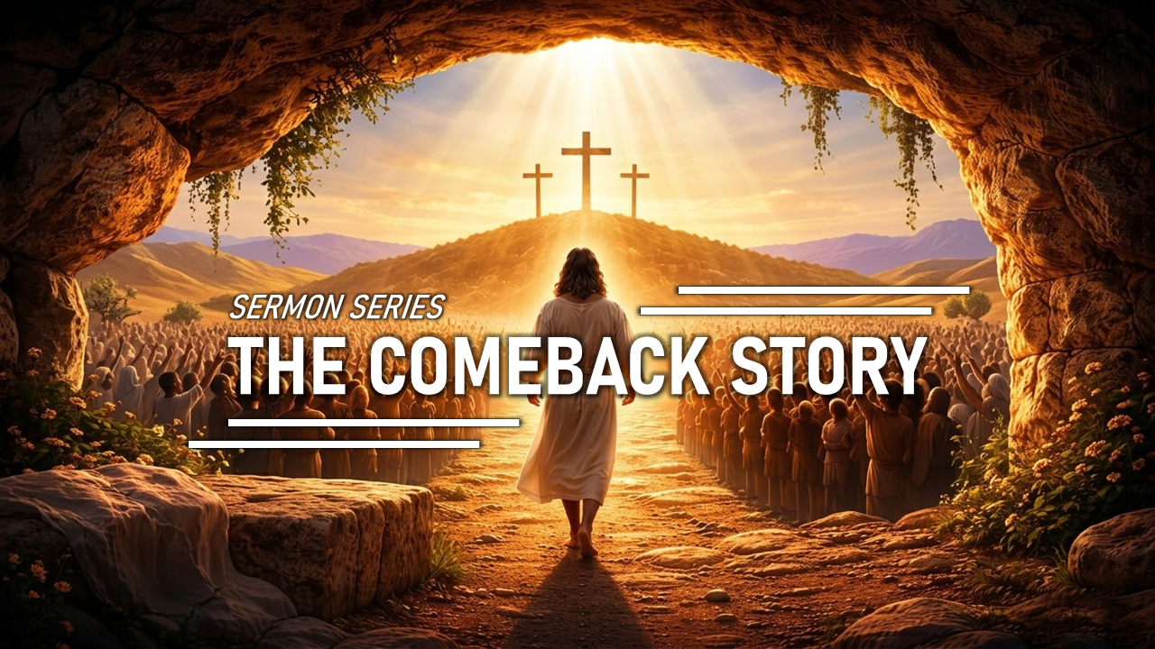

ANNOUNCEMENT
Welcome
1. LIFE GROUP! If you are not in one please let us know.
2. Sanctuary Spring Cleaning! Join us for a time of serving together!
April 11(SAT) 10:00 AM – 12:00 PM
3. At the Movies
Which Movie? The Case for Christ
When? Some other Sunday soon, 12:30 PM (after service)
What to bring? Yourself. If you want to, bring your favorite snacks!
4. Sermon Series! THE COMEBACK STORY! (March 22 - April 5, 2026)
CHOONGJUNG CHURCH
Easter Sunday
CHOONGJUNG
ENGLISH
MINISTRY
KIDS 09:30 AM for Elementary Students
LIFE 11:30 AM for Youth & Adults
SUNDAY BULLETIN
PASTOR & STAFF
APRIL 5, 2026
PASTOR | Daniel Chung (정다니엘 목사) 010-8101-0940 Yaqub Kashif(야곱 목사) 010-5897-2490
DIRECTOR | LIFE Elder Paul Jeong (정희대 장로) 010-3911-1586 KIDS Deacon Spencer Hwang(황규문 집사) 010-2304-6267
ASST DIRECTOR | Deacon Ebraim Shin (신승환 집사) 010-2304-6267
PRAISE TEAM : NUEVOS SCRIPTURE READING TEAM : VOICE OF LIFE
2026 CHURCH VISION
2026 CEM VISION : REACTION
EVEN THERE YOUR HAND WILL GUIDE ME,
YOUR RIGHT HAND WILL HOLD ME FAST.
WE PROCLAIM TO YOU
WHAT WE HAVE SEEN AND HEARD
SO THAT YOU ALSO
MAY HAVE FELLOWSHIP WITH US ...
PSALMS 139:10
1 JOHN 1:3

Slide 2



ORDER OF SERVICE
SERMON NOTES
PRAISE | NUEVOS
PRAYER | Deaconess Shine Park
GREETING | Jesus is our risen Savior.
ANNOUNCEMENT & WELCOME NEWCOMERS
SCRIPTURE | Matthew 28:6
SERMON | THE RESURRECTION REV. DANIEL CHUNG
PRAYER
OFFERING | “complete”
BENEDICTION
LIFE GROUP
LIFE GROUP QUESTIONS
1 | The Bible says death has lost its power. Yet what still makes death or loss feel strong or fearful to you? // 성경은 죽음의 권세가 무너졌다고 말합니다. 그런데도 여전히 죽음이나 상실이 크게 느껴지는 이유는 무엇일까요?
2 | If resurrection is truly your future, how should that reshape the way you see your current struggles or fears? // 부활이 우리의 확실한 미래라면, 지금의 어려움이나 두려움을 바라보는 시각은 어떻게 달라져야 할까요?
3 | Because Jesus has already won the victory, what is one way you can live with hope and confidence this week instead of fear? // 예수님께서 이미 승리를 이루셨다면, 이번 주를 두려움이 아니라 소망과 담대함으로 살아가기 위한 한 가지 실천은 무엇일까요?
KAKAO CHANNEL
www.ilsanenglishworship.org @ilsanenglishworshipcem
3F, 244, Ilsan-ro, Ilsandong-gu, Goyang-si, Gyeonggi-do, Korea, 10417

