Slide 1



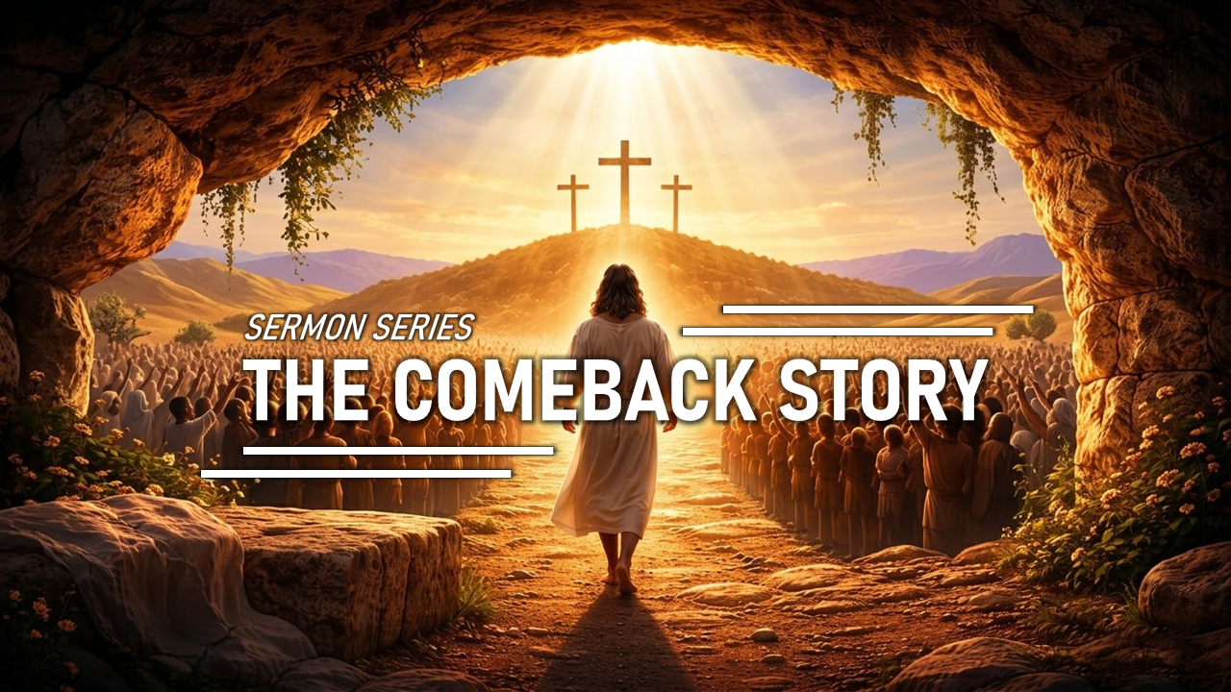
ANNOUNCEMENT
Welcome
1. LIFE GROUP will be starting. Please pray and let us if you’re not in the group.
2. LIFE GROUP guide is in the front desk. We hope to grow together as a community united by the same vision.
3. Bible Study of Revelations & Genesis: Please sign up.
4. We are going to have the sermon series called THE COMEBACK STORY!
(March 22 - April 5, 2026)
CHOONGJUNG CHURCH
CHOONGJUNG
ENGLISH
MINISTRY
KIDS 09:30 AM for Elementary Students
LIFE 11:30 AM for Youth & Adults
SUNDAY BULLETIN
PASTOR & STAFF
MARCH 22, 2026
PASTOR | Daniel Chung(정다니엘 목사) 010-8101-0940 Yaqub Kashif(야곱 목사) 010-5897-2490
DIRECTOR | LIFE Elder Paul Jeong(정희대 장로) 010-3911-1586 KIDS Deacon Spencer Hwang(황규문 집사) 010-2304-6267
ASST DIRECTOR | Deacon Ebraim Shin(신승환 집사) 010-2304-6267
PRAISE TEAM : NUEVOS SCRIPTURE READING TEAM : VOICE OF LIFE
2026 CHURCH VISION
2026 CEM VISION : REACTION
EVEN THERE YOUR HAND WILL GUIDE ME,
YOUR RIGHT HAND WILL HOLD ME FAST.
WE PROCLAIM TO YOU
WHAT WE HAVE SEEN AND HEARD
SO THAT YOU ALSO
MAY HAVE FELLOWSHIP WITH US ...
PSALMS 139:10
1 JOHN 1:3

Slide 2



ORDER OF SERVICE
SERMON NOTES
PRAISE | NUEVOS
PRAYER | Sister Sandy Kim
GREETING | Jesus loves you to the end.
ANNOUNCEMENT & WELCOME NEWCOMERS
SCRIPTURE | John 12:13
SERMON | HOSANNA REV. DANIEL CHUNG
PRAYER
OFFERING | “complete”
BENEDICTION
LIFE GROUP
LIFE GROUP QUESTIONS
1 | The crowd praised Jesus but wanted Him to meet their expectations. In what ways can we follow Jesus while still expecting Him to fit our plans? // 사람들은 예수님을 찬양했지만, 결국 자신들의 기대를 이루어 주길 원했습니다. 우리도 예수님을 따르면서 여전히 내 계획에 맞추려 할 때는 어떤 모습일까요?
2 | When God doesn’t do what we expect, what does that reveal about what we truly love or trust? // 하나님이 우리의 기대대로 일하지 않으실 때, 그것은 우리가 실제로 무엇을 사랑하고 신뢰하는지를 어떻게 드러내나요?
3 | Jesus chose the cross for us while we were still sinners. How does His love change the way you want to respond to Him this week? // 우리가 아직 죄인 되었을 때에도 예수님은 십자가를 선택하셨습니다. 그 사랑이 이번 주에 예수님께 반응하는 당신의 삶을 어떻게 바꾸고 싶게 만드나요?
KAKAO CHANNEL
www.ilsanenglishworship.org @ilsanenglishworshipcem
3F, 244, Ilsan-ro, Ilsandong-gu, Goyang-si, Gyeonggi-do, Korea, 10417

