Slide 1
SERMON
LIFE
GROUP
ACTS 2:42-47

Slide 2
ACTS 2:42-47
42 They devoted themselves to the apostles' teaching
and to fellowship, to the breaking of bread and to prayer.
43 Everyone was filled with awe at the many wonders
and signs performed by the apostles.
44 All the believers were together
and had everything in common.
45 They sold property and possessions
to give to anyone who had need.
LIFE
GROUP

Slide 3
ACTS 2:42-47
46 Every day they continued to meet together
in the temple courts. They broke bread in their homes
and ate together with glad and sincere hearts,
47 praising God and enjoying the favor of all the people.
And the Lord added to their number daily
those who were being saved.
LIFE
GROUP

Slide 4




Slide 5
focus

Slide 6

ambiguous
image
focus

Slide 7
ambiguous
image
focus

Slide 8

focus

Slide 9
God’s
focus

Slide 10

SERMON
Reaction
1 John 1:3

Slide 11
1 John 1:3
We proclaim to you
what we have seen and heard,
so that you also may have fellowship with us.
And our fellowship is
with the Father
and with his Son, Jesus Christ.

Slide 12
Religion
Relationship
got to
get to
해야만 한다
할 수 있게 되었다
obligation
privilege
의무
특권

Slide 13
True Spiritual Life
Know God’s love for us
Relationship
&
w/ God
React to it

Slide 14


as a church
?

Slide 15
as a church
WHY?
WHAT?

Slide 16
WHY?
THE GREAT COMMISSION

Slide 17
THE GREAT COMMISSION
MATTHEWS 28:19-20
19 Therefore go and make disciples of all nations,
baptizing them in the name of the Father
and of the Son and of the Holy Spirit,
20 and teaching them to obey everything
I have commanded you.
And surely I am with you always,
to the very end of the age.

Slide 18
WHAT?
THE EARLY CHURCH
ACTS 2:42-47
42 They devoted themselves to the apostles' teaching
and to fellowship, to the breaking of bread and to prayer.
43 Everyone was filled with awe at the many wonders
and signs performed by the apostles.
44 All the believers were together
and had everything in common.
45 They sold property and possessions
to give to anyone who had need.
46 Every day they continued to meet together
in the temple courts. They broke bread in their homes
and ate together with glad and sincere hearts,
47 praising God and enjoying the favor of all the people.
And the Lord added to their number daily
those who were being saved.

Slide 19
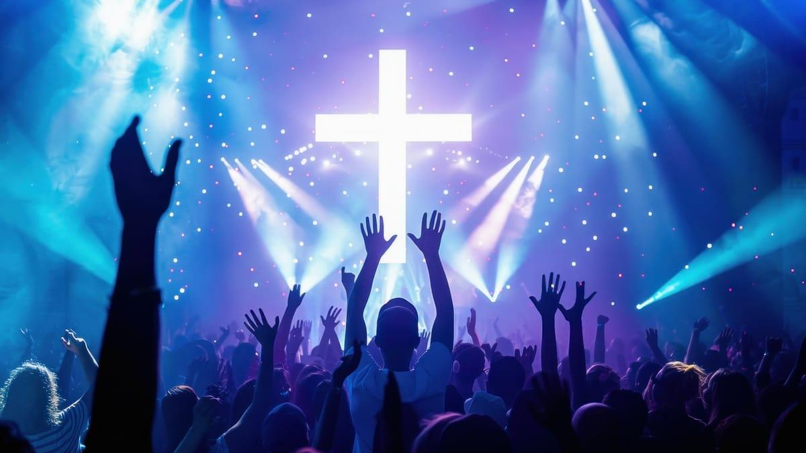
42 They devoted themselves to the apostles' teaching
and to fellowship, to the breaking of bread and to prayer.
43 Everyone was filled with awe at the many wonders
and signs performed by the apostles.
44 All the believers were together
and had everything in common.
45 They sold property and possessions
to give to anyone who had need.
46 Every day they continued to meet together
in the temple courts. They broke bread in their homes
and ate together with glad and sincere hearts,
47 praising God and enjoying the favor of all the people.
And the Lord added to their number daily
those who were being saved.
ACTS 2:42-47
1. WORSHIP

Slide 20

42 They devoted themselves to the apostles' teaching
and to fellowship, to the breaking of bread and to prayer.
43 Everyone was filled with awe at the many wonders
and signs performed by the apostles.
44 All the believers were together
and had everything in common.
45 They sold property and possessions
to give to anyone who had need.
46 Every day they continued to meet together
in the temple courts. They broke bread in their homes
and ate together with glad and sincere hearts,
47 praising God and enjoying the favor of all the people.
And the Lord added to their number daily
those who were being saved.
ACTS 2:42-47
2. FELLOWSHIP

Slide 21

ACTS 2:42-47
42 They devoted themselves to the apostles' teaching
and to fellowship, to the breaking of bread and to prayer.
43 Everyone was filled with awe at the many wonders
and signs performed by the apostles.
44 All the believers were together
and had everything in common.
45 They sold property and possessions
to give to anyone who had need.
46 Every day they continued to meet together
in the temple courts. They broke bread in their homes
and ate together with glad and sincere hearts,
47 praising God and enjoying the favor of all the people.
And the Lord added to their number daily
those who were being saved.
3. DISCIPLESHIP

Slide 22
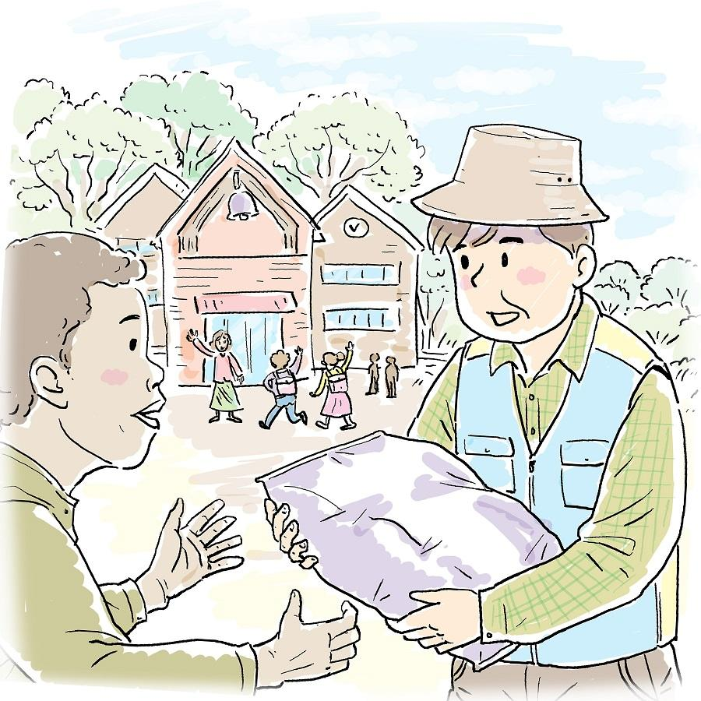
42 They devoted themselves to the apostles' teaching
and to fellowship, to the breaking of bread and to prayer.
43 Everyone was filled with awe at the many wonders
and signs performed by the apostles.
44 All the believers were together
and had everything in common.
45 They sold property and possessions
to give to anyone who had need.
46 Every day they continued to meet together
in the temple courts. They broke bread in their homes
and ate together with glad and sincere hearts,
47 praising God and enjoying the favor of all the people.
And the Lord added to their number daily
those who were being saved.
ACTS 2:42-47
4. MINISTRY/
SERVE

Slide 23

42 They devoted themselves to the apostles' teaching
and to fellowship, to the breaking of bread and to prayer.
43 Everyone was filled with awe at the many wonders
and signs performed by the apostles.
44 All the believers were together
and had everything in common.
45 They sold property and possessions
to give to anyone who had need.
46 Every day they continued to meet together
in the temple courts. They broke bread in their homes
and ate together with glad and sincere hearts,
47 praising God and enjoying the favor of all the people.
And the Lord added to their number daily
those who were being saved.
WHAT?
2. FELLOWSHIP
1. WORSHIP
ACTS 2:42-47
3. DISCIPLESHIP
5. MISSION/
EVANGELISM
4. MINISTRY/
SERVE

Slide 24
WHAT?
1. WORSHIP
2. FELLOWSHIP
3. DISCIPLESHIP
4. MINISTRY/
SERVE
5. MISSION/
EVANGELISM

Slide 25
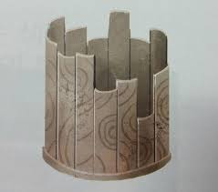
WHAT?
1. WORSHIP
2. FELLOWSHIP
3. DISCIPLESHIP
4. MINISTRY/
SERVE
5. MISSION/
EVANGELISM

Slide 26
WHAT?
1. WORSHIP
2. FELLOWSHIP
3. DISCIPLESHIP
Impossible
for
Large Group
4. MINISTRY/
SERVE
5. MISSION/
EVANGELISM

Slide 27

WHAT?
1. WORSHIP
2. FELLOWSHIP
ONLY
3. DISCIPLESHIP
SMALL
4. MINISTRY/
SERVE
GROUP
5. MISSION/
EVANGELISM

Slide 28
LIFE
CEM
SMALL
GROUP
ACTS 2:42-47

Slide 29
CEM
LIFE
GROUP
ACTS 2:42-47

Slide 30
CEM
LIFE
1. WORSHIP
PRAISE & PRAYER
GROUP
2. WORD
ACTS 2:42-47

Slide 31
CEM
LIFE
1. WORSHIP
2. WORD
GROUP
SHARE HEARTS
3. WITNESS
ACTS 2:42-47

Slide 32
CEM
LIFE
1. WORSHIP
2. WORD
GROUP
3. WITNESS
MAKE DECISIONS
ACTS 2:42-47

Slide 33
1. WORSHIP
CEM
LIFE
PRAISE & PRAYER
2. WORD
GROUP
SHARE HEARTS
3. WITNESS
ACTS 2:42-47
MAKE DECISIONS

Slide 34
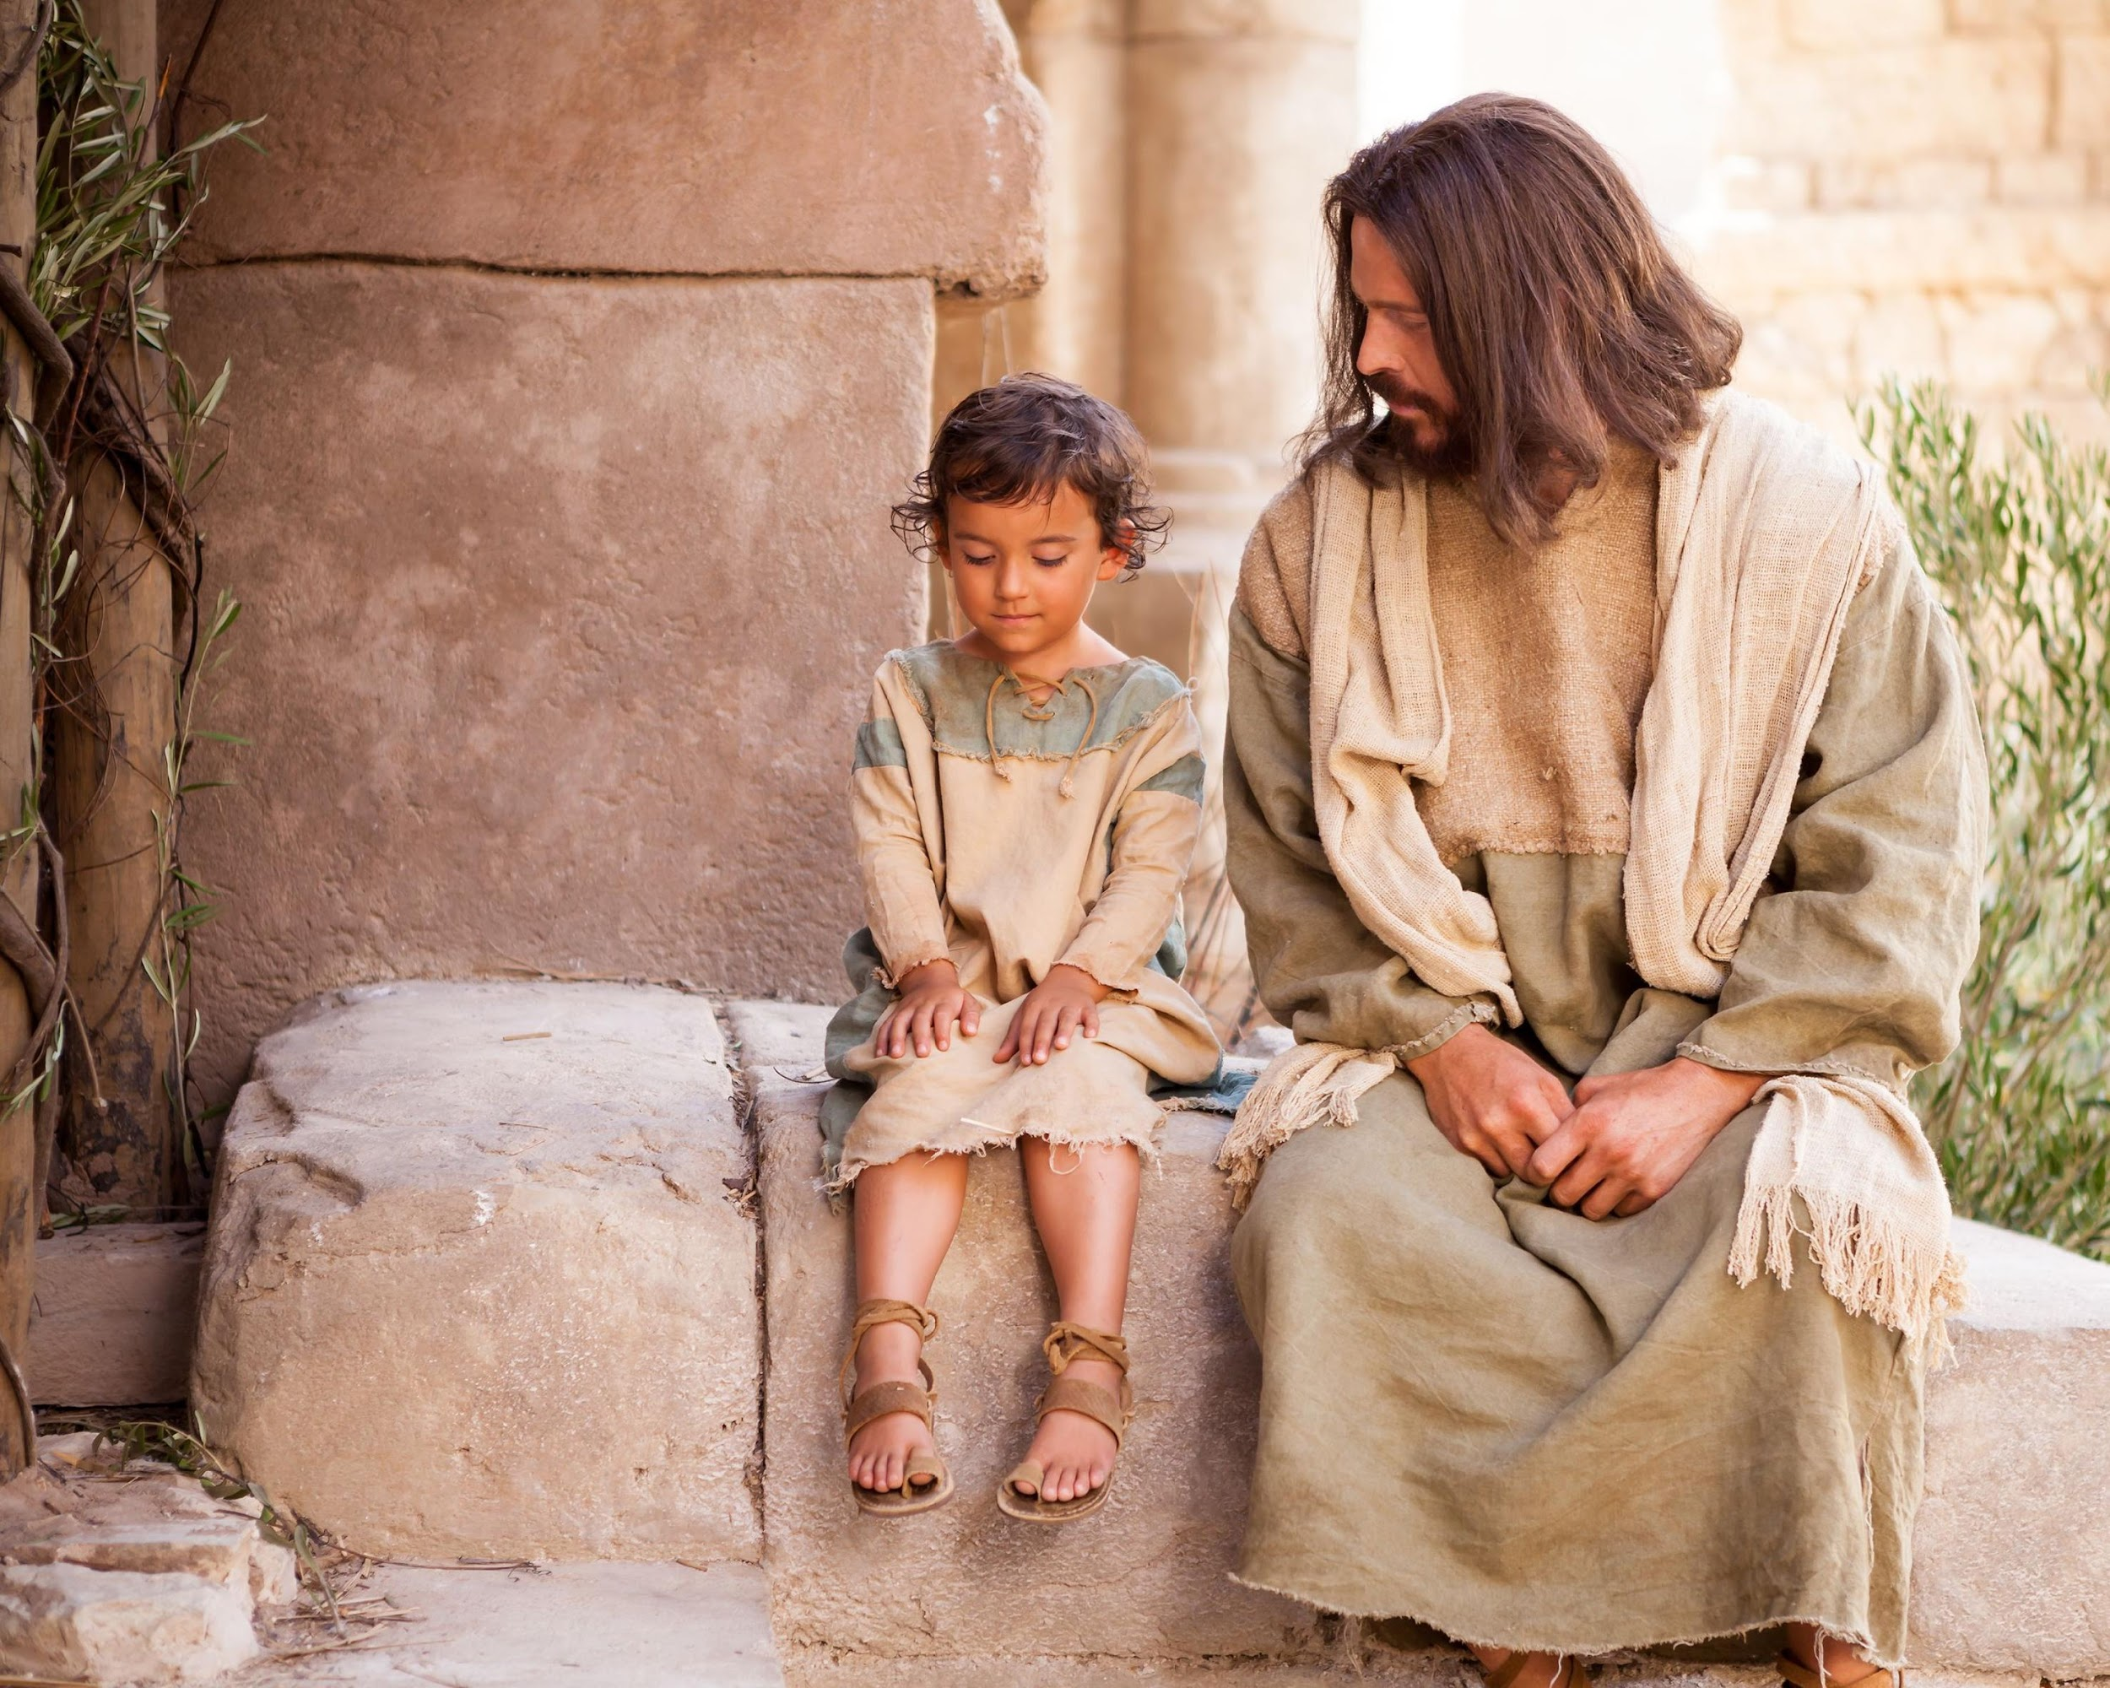
LIFE
GROUP

