Slide 1

SERMON
Reaction
1 John 1:3

Slide 2
1 John 1:3
We proclaim to you
what we have seen and heard,
so that you also may have fellowship with us.
And our fellowship is
with the Father
and with his Son, Jesus Christ.

Slide 3
SERMON
Reaction
1 John 1:3

Slide 4


Slide 5

Happy birthday to you
Happy birthday to you
Happy birthday dear ○○○
Happy birthday to you

Slide 6
Happy birthday to you
Happy birthday to you
Happy birthday dear ○○○
Happy birthday to you
왜 태어났니?
왜 태어났니?
공부도 못하면서
왜 태어났니?

Slide 7
왜 태어났니?
왜 태어났니?
공부도 못하면서
왜 태어났니?
Why were you even born?
Why were you even born?
If you can’t study well,
why were you even born?

Slide 8
왜 태어났니?
왜 태어났니?
공부도 못하면서
왜 태어났니?
Why were you even born?
Why were you even born?
If you can’t study well,
why were you even born?

Slide 9
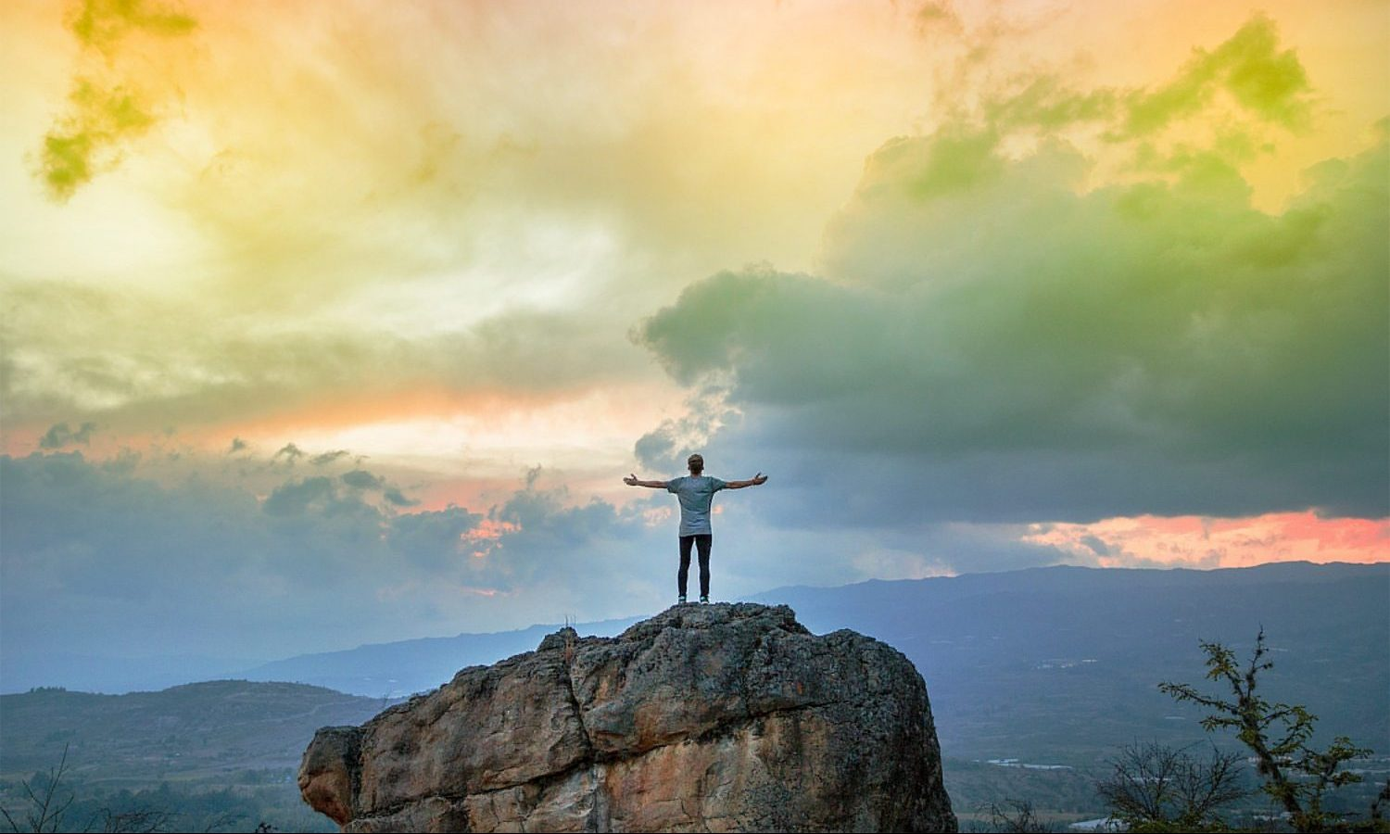
?
Why
?

Slide 10
?
Why do we
go to church
?

Slide 11
?
Why is there evil
in this world
even if God is good
?

Slide 12
?
Why Christianity
is the only truth
?

Slide 13
?
Why on earth
do we even exist
?

Slide 14

?
Why
?

Slide 15

Postmodernism

Slide 16
Postmodernism
Truth is subjective

Slide 17
Postmodernism
There are
no absolute truth
is the absolute truth

Slide 18

Affirmation
긍정
Confirmation
확증

Slide 19
Affirmation
긍정
Confirmation
확증
Truth

Slide 20


Slide 21


Slide 22
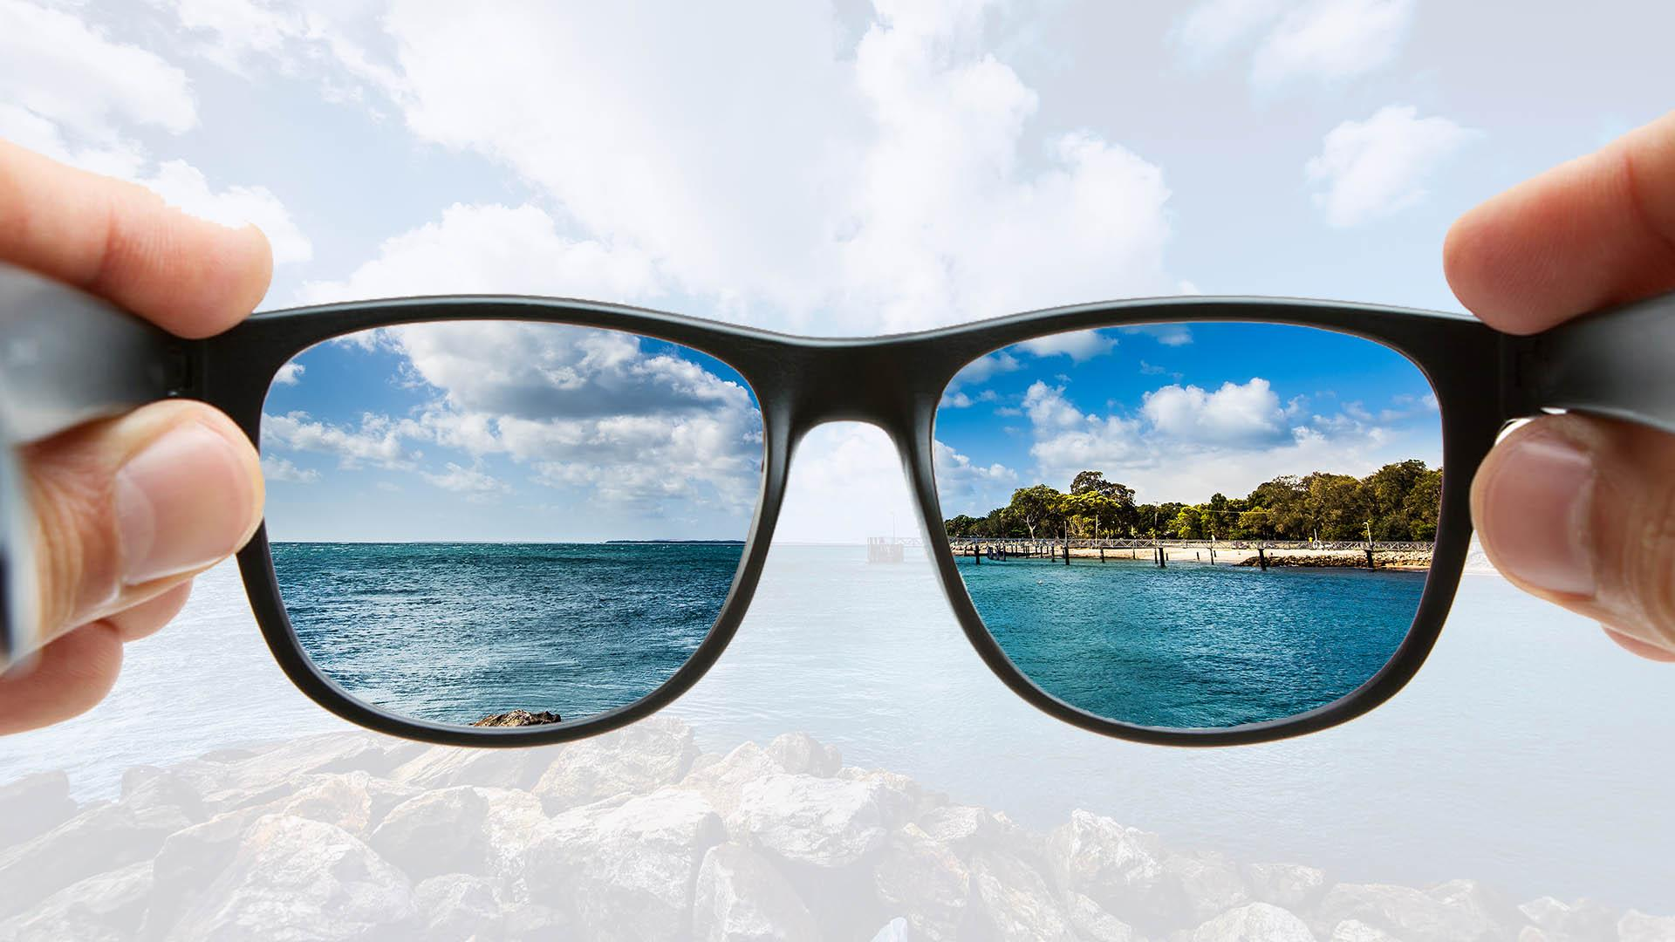
worldview

Slide 23

worldview

Slide 24
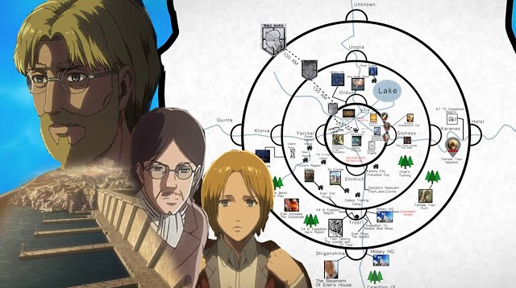
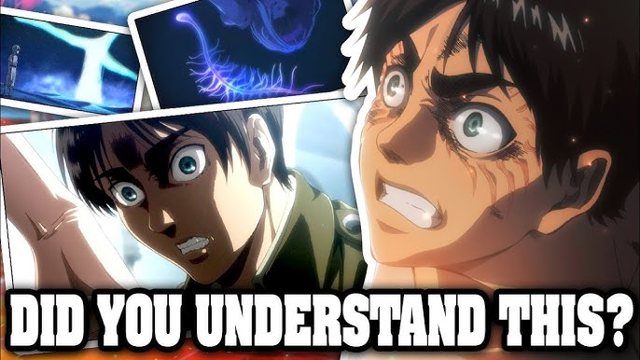


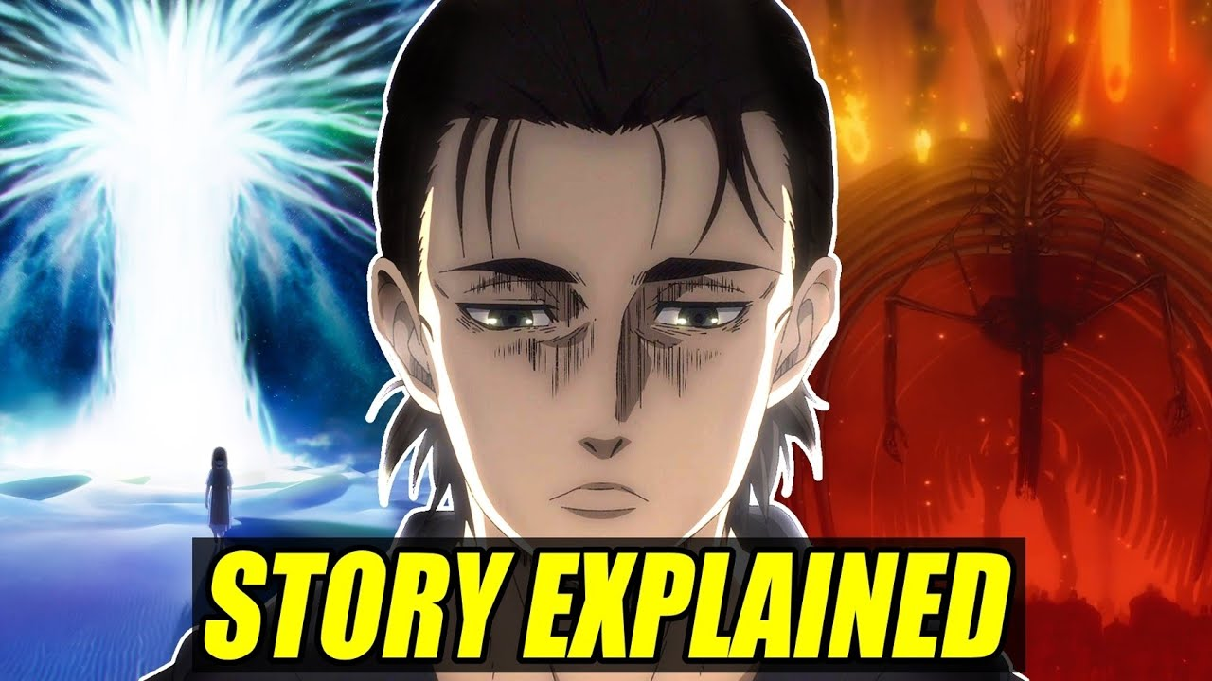
worldview

Slide 25
worldview

Slide 26
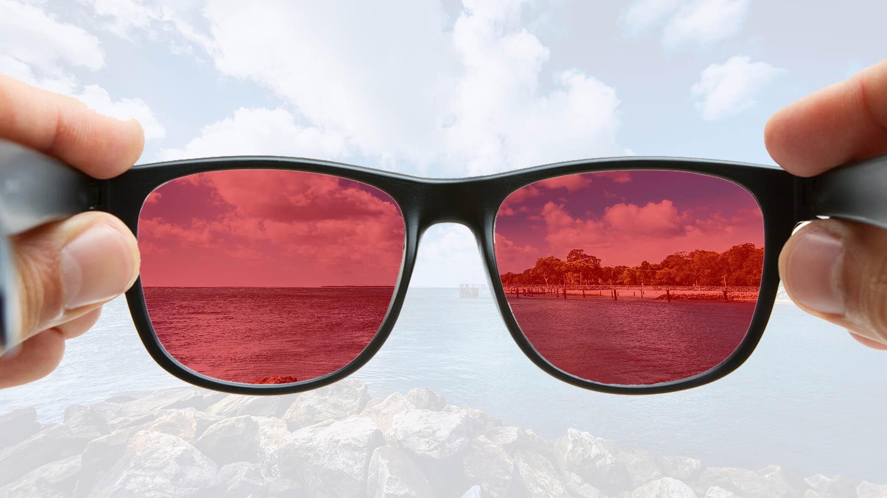
worldview

Slide 27

worldview

Slide 28


Human
Words
God’s
Words
Error

Slide 29
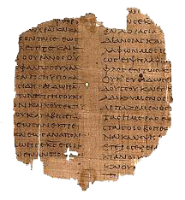
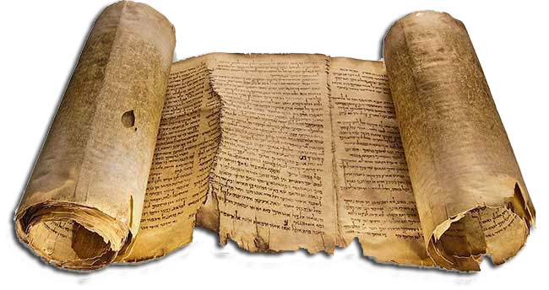
manuscripts

Slide 30
Author | Written | 1st Copy | Elapsed Time | Number of Copies | Accuracy
Platon | B.C. 400 | A.D. 900 | 1300 yrs | 7 | -
Caesar | B.C. 100 | A.D. 900 | 1000 yrs | 10 | -
Libby | A.D. 17 | A.D. 900 | 900 yrs | 20 | -
Tecitus | A.D. 100 | A.D. 1100 | 1000 yrs | 20 | -
Aristotle | B.C. 300 | A.D. 1100 | 1400 yrs | 49 | -
Socrates | B.C. 400 | A.D. 1000 | 1400 yrs | 193 | -
Homer(Iliad) | B.C. 900 | B.C. 400 | 500 yrs | 643 | 95%
New Testament | A.D. 100 | A.D. 130-200 | < 100 yrs | 5600 | 99.5%

Slide 31
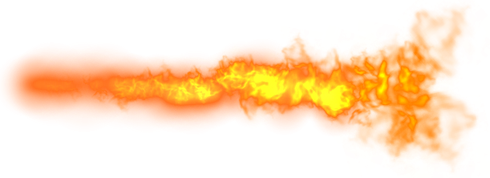

2 Timothy 3:16
All Scripture is
breathed out by God
and profitable
for teaching,
for reproof,
for correction,
and for training
in righteousness

Slide 32

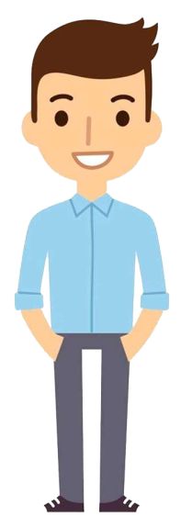
Author : God

Slide 33
1 John 1:3
We proclaim to you
what we have seen and heard,
so that you also may have fellowship with us.
And our fellowship is
with the Father
and with his Son, Jesus Christ.

Slide 34
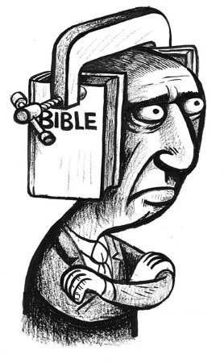
Not just
Knowledge

Slide 35


Slide 36
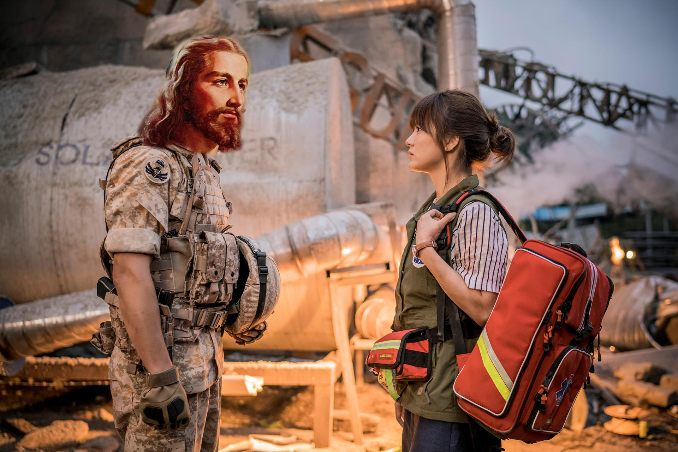

Slide 37
True Spiritual Life

Slide 38

True Spiritual Life
Know God’s love for us

Slide 39
True Spiritual Life
Know God’s love for us
&
React to it

Slide 40
True Spiritual Life
Know God’s love for us
Relationship
w/ God
&
React to it

Slide 41

React to it

Slide 42
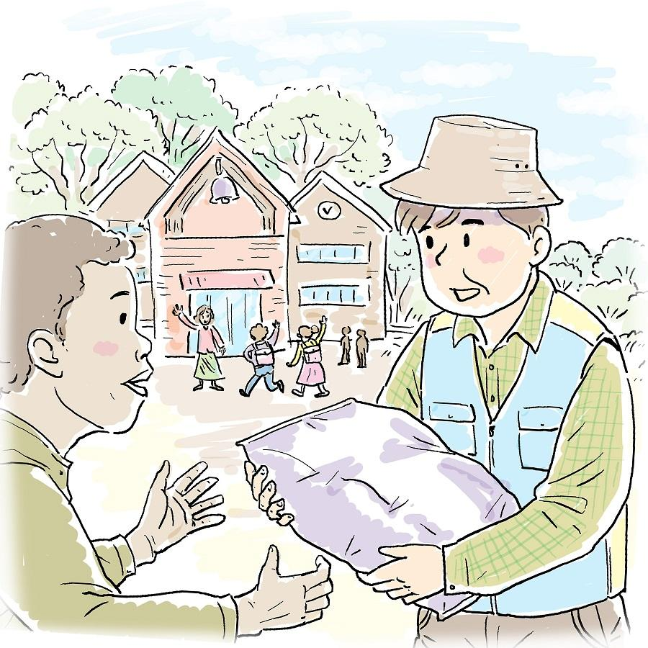
React to it

Slide 43
Religion
Relationship
got to
get to
해야만 한다
할 수 있게 되었다
obligation
privilege
의무
특권

Slide 44
?
So, what kind of
are you in
with Jesus
Relationship

Slide 45




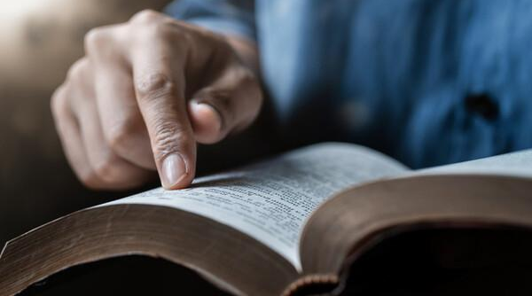
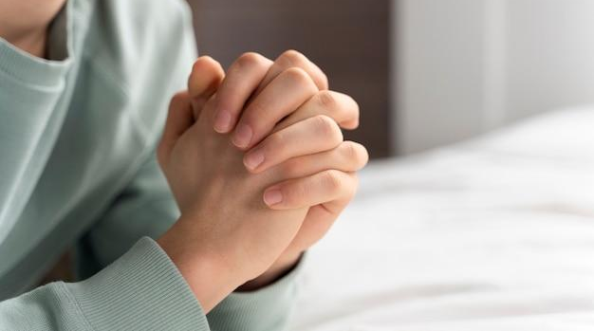
?

Slide 46
