Slide 1
LET IT BEGIN NOW!
BOOK OF ACTS 1:1-11
Rev. Yaqub Kashif

Slide 2
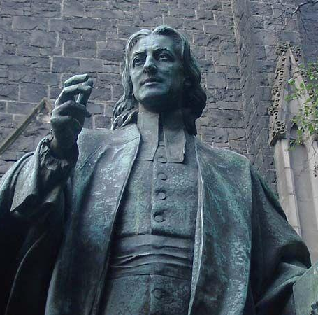
John Wesley (born June 17, 1703, Epworth, Lincolnshire, England—died March 2, 1791, London)

Slide 3
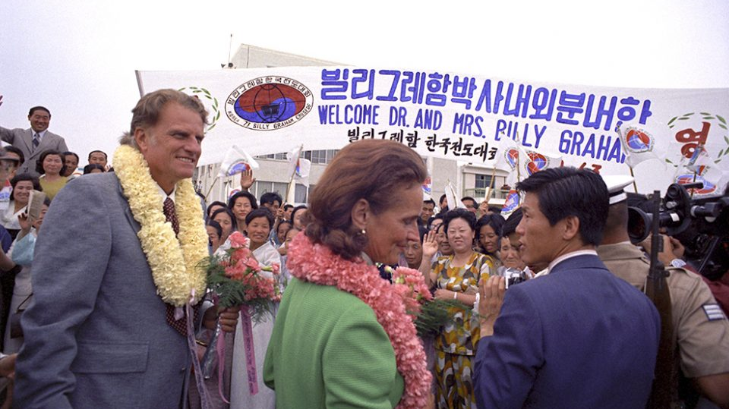

Slide 4
A Fresh Encounter with Jesus
Before the disciples could receive their mission, they needed to encounter the risen Christ.
John Wesley’s life was changed at Aldersgate in 1738—he truly encountered God.
Billy Graham 1940 “Do it Again Lord”
Meditate on the words and works of Jesus.
"Lord, open our eyes to see You afresh."

Slide 5
Requires the Power of the Holy Spirit
Jesus commanded the disciples to wait for the Holy Spirit
Billy Graham "The Holy Spirit is the one who convicts, converts, and empowers.“
Seek the Holy Spirit daily and ask for fresh empowerment. (ACTS 2:38 repent & baptized)

Slide 6
Obedience to God’s Commission 1:6-8
Jesus redirected them to a global mission.
Graham and Wesley obeyed God’s call to preach.
Identify one way to act on God’s call this week.
"Father, align my heart with Your mission. Let my life be a channel for Your glory."

Slide 7
Urgency and Readiness 1:9-11
The angels reminded the disciples that the time to act is now, as Jesus is coming back.
Urgency preaching: Each soul matters.
Live each day as though Jesus could return tomorrow.
"Lord, ignite a sense of urgency in my heart."

Slide 8
Let It Begin Now!
God is calling us to rise up and step into our calling.
Revival begins with us.
Time to move and act on God’s calling.

Slide 9
Pray

