Slide 1
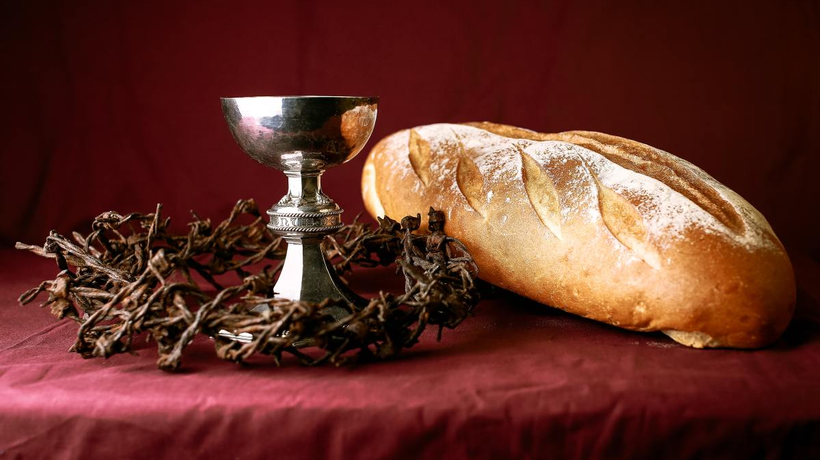
HOLY COMMUNION

Slide 2

For I received from the Lord what I also passed on to you:
The Lord Jesus, on the night he was betrayed, took bread, and when he had given thanks,
he broke it and said, “This is my body, which is for you; do this in remembrance of me.”
In the same way, after supper he took the cup, saying,
“This cup is the new covenant in my blood; do this, whenever you drink it, in remembrance of me.”
For whenever you eat this bread and drink this cup,
you proclaim the Lord’s death until he comes. (1 Cor 11:23-26).

Slide 3
HOLY COMMUNION

Slide 4
Breaking Bread, 분병:
John 6:35 - Then Jesus declared, “I am the bread of life. Whoever comes to me will never go hungry, and whoever believes in me will never be thirsty.

Slide 5
Breaking Bread, 분병:
John 6:35 - Then Jesus declared, “I am the bread of life. Whoever comes to me will never go hungry, and whoever believes in me will never be thirsty.
Drinking the wine, 분잔:
Matthew 26:28 - This is my blood of the covenant, which is poured out for many for the forgiveness of sins.

Slide 6
HOLY COMMUNION

