Slide 1
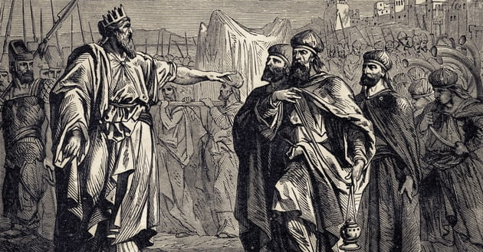
David’s Kingdom, God’s Kingdom
20231022
2 Sam 7;7-18

Slide 2
Davidic Covenant

Slide 3
Covenant of Work
(By our deeds)
Adam & Eve - Failed

Slide 4
Covenant of Work
(By our deeds)
Adam & Eve - Failed
Covenant of Grace
(By His grace)
Noah (Genesis 9, known for the rainbow)
Abraham (Genesis 12, 15, 17, Stars)
Moses (Exodus~Deut, 10 Comms the Law)
Exodus 19:5-6, 1 Peter 2:9-10)
David (2 Sam 7)

Slide 5
Covenant of Grace
(By His grace)
Noah (Genesis 9, known for the rainbow)
Abraham (Genesis 12, 15, 17, Stars)
Moses (Exodus~Deut, 10 Comms the Law)
Exodus 19:5-6, 1 Peter 2:9-10)
Exodus 19:5-6 Now if you obey me fully and keep my covenant, then out of all nations you will be my treasured possession. Although the whole earth is mine, you will be for me a kingdom of priests and a holy nation.’ These are the words you are to speak to the Israelites.”
1 Peter 2:9-10 But you are a chosen people, a royal priesthood, a holy nation, God’s special possession, that you may declare the praises of him who called you out of darkness into his wonderful light. Once you were not a people, but now you are the people of God; once you had not received mercy, but now you have received mercy.

Slide 6
Covenant of Work
(By our deeds)
Adam & Eve - Failed
Covenant of Grace
(By His grace)
Noah (Genesis 9, known for the rainbow)
Abraham (Genesis 12, 15, 17, Stars)
Moses (Exodus~Deut, 10 Comms the Law)
Exodus 19:5-6, 1 Peter 2:9-10)
David (2 Sam 7)

Slide 7
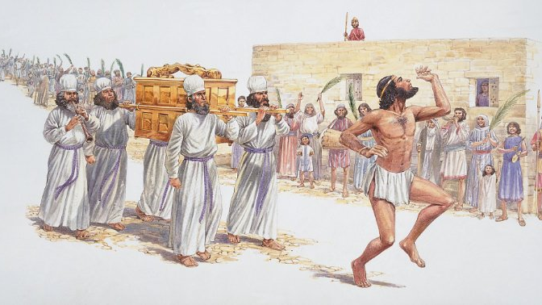

Slide 8
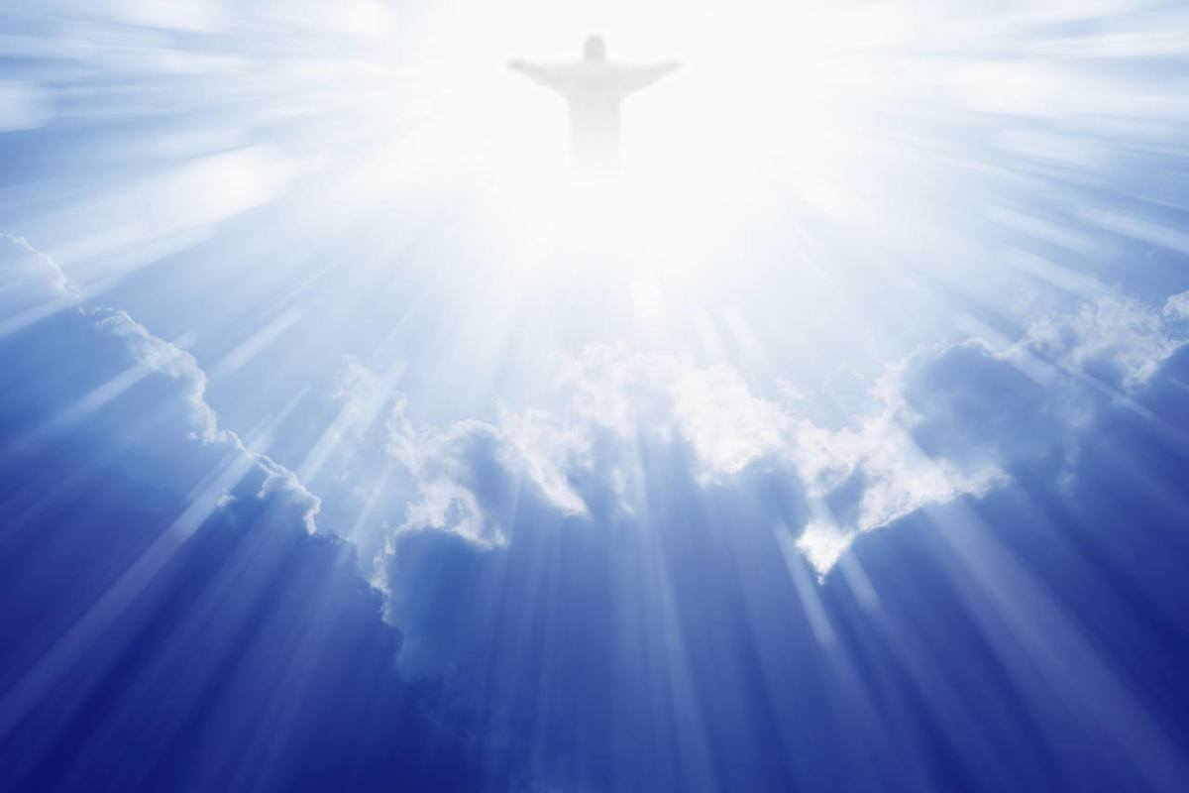

Slide 9
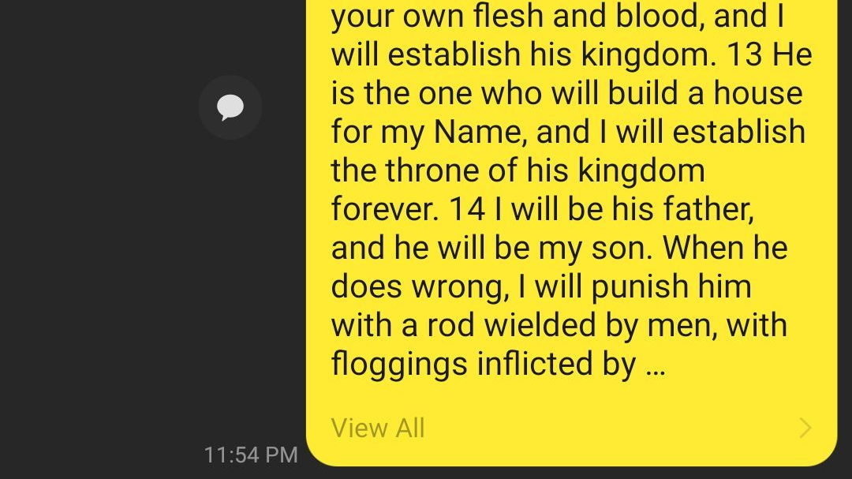

Slide 11
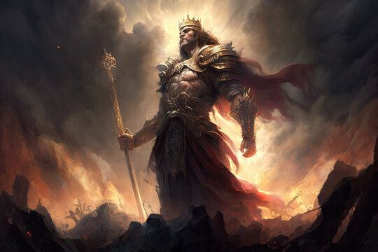

Slide 12
Thanksgiving

Slide 13
David’s Kingdom, God’s Kingdom
20221106
1 Sam 16;1-11

