Slide 1
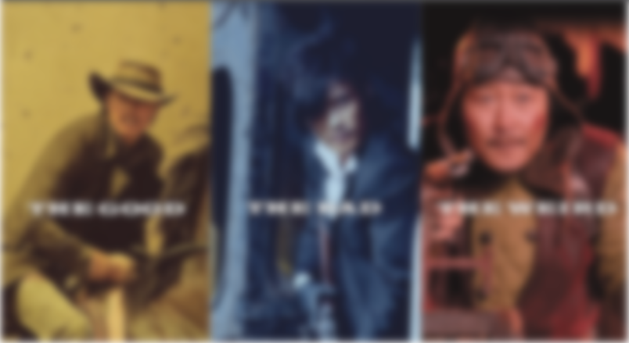
Which one is you?
20221016
2 Sam 6:12-24

Slide 2


Slide 3
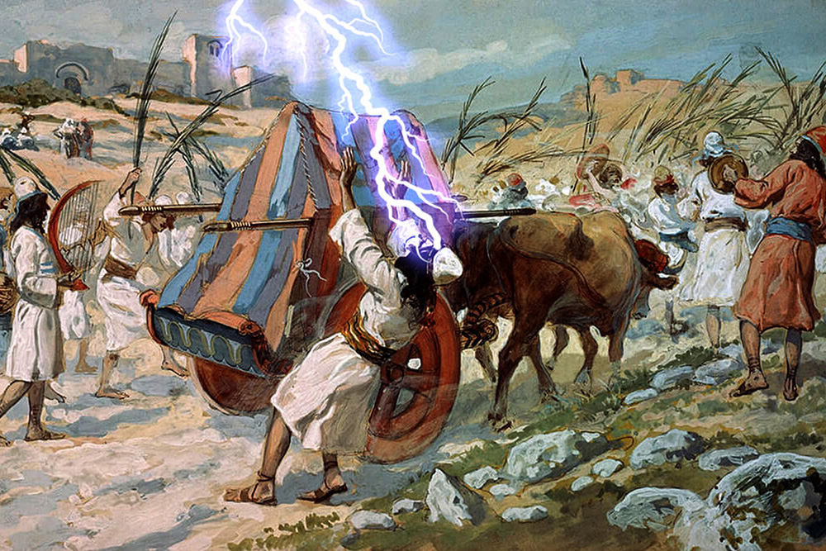

Slide 4
Dead
Worshiper

Slide 5
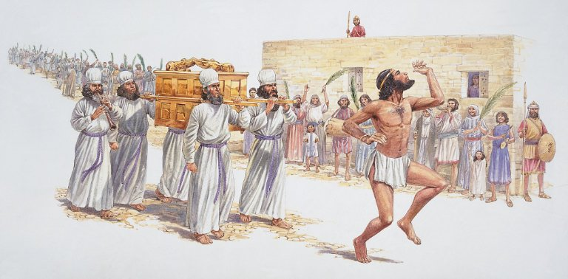

Slide 6
Dancing
Worshiper

Slide 7
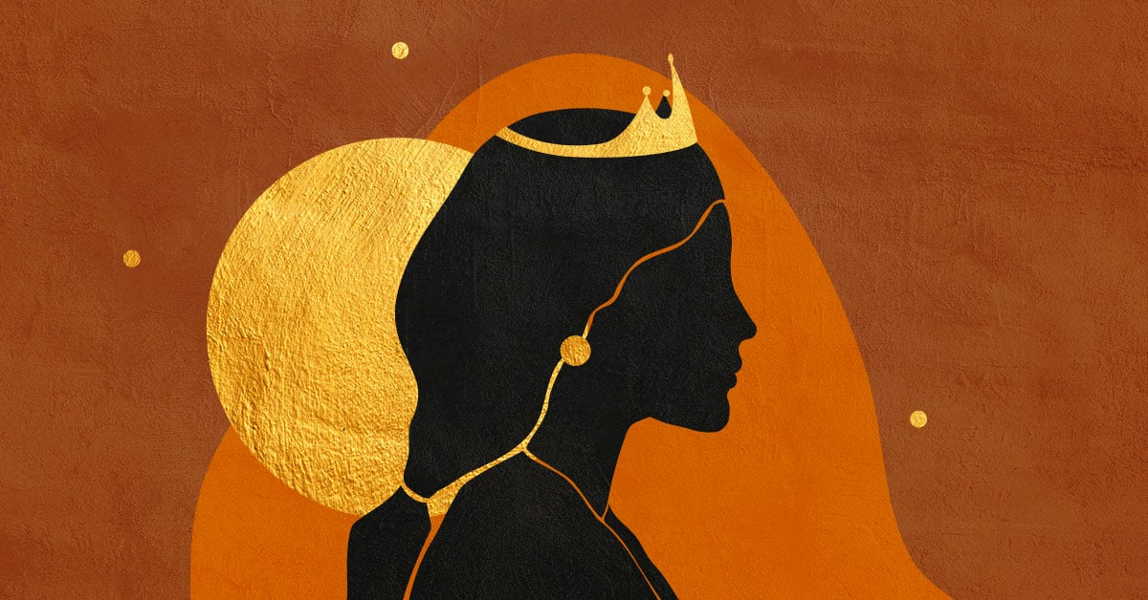

Slide 8
Worship
Judge

Slide 10
Which one is you?
20221016
2 Sam 6:12-24

