Slide 1

Mom
& Grandma
20231001
2 Timothy 1:3-5

Slide 2


Slide 3
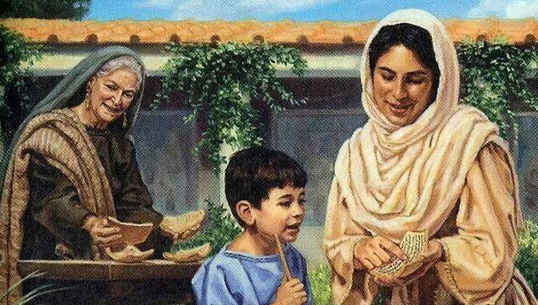

Slide 4
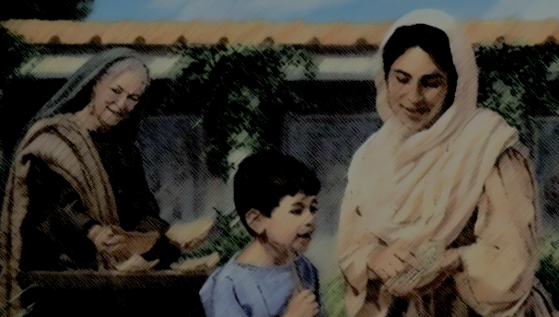
Acts 16:1
Paul came to Derbe and then to Lystra,
where a disciple named Timothy lived,
whose mother was Jewish and a believer but whose father was a Greek.

Slide 6
2 Timothy 14-15
But as for you, continue in what you have learned and have become convinced of, because you know those from whom you learned it, and how from infancy you have known the Holy Scriptures, which are able to make you wise for salvation through faith in Christ Jesus.

Slide 8
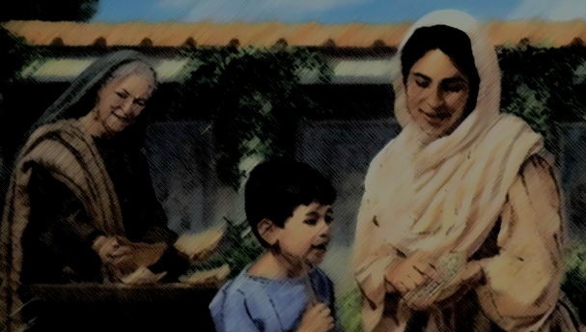
What to think again……
1. We need the prayer and worship of heart.
마음의 기도와 마음의 예배를 드립시다.
2. Serve the Lord with your heart
온 마음 다해 주님을 섬겨야 합니다.
3. We need the circumcision of heart.
마음의 할례를 받아야 합니다.

Slide 9
Mom
& Grandma
20231001
2 Timothy 1:3-5

