Slide 1

We all need a new heart
20230917
Ezekiel 36:26

Slide 2


Slide 3
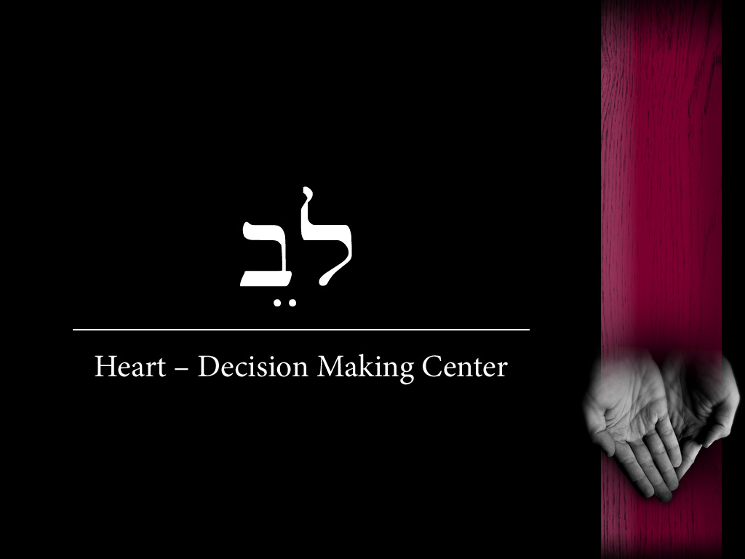


Slide 4
Proverbs 4:23 - Above all else, guard your heart, for everything you do flows from it.

Slide 5
About heart
1:8 - Her husband Elkanah would say to her, “Hannah, why are you weeping? Why don’t you eat? Why are you downhearted? Don’t I mean more to you than ten sons?”
1:13 - Hannah was praying in her heart, and her lips were moving but her voice was not heard. Eli thought she was drunk
Q: Do you worship and pray with your heart?

Slide 6
About heart
1 Samuel 7:3 - “If you are returning to the Lord with all your hearts, then rid yourselves of the foreign gods and the Ashtoreths and commit yourselves to the Lord and serve him only
Q: Do you repent with your heart?

Slide 7
About heart
1 Samuel 7:3 - “If you are returning to the Lord with all your hearts, then rid yourselves of the foreign gods and the Ashtoreths and commit yourselves to the Lord and serve him only,
1 John 1:9 - If we confess our sins, he is faithful and just and will forgive us our sins and purify us from all unrighteousness.

Slide 8
About heart
1 Samuel 10:9 - As Saul turned to leave Samuel, God changed Saul’s heart, and all these signs were fulfilled that day.
Request:
Pray God He renews your heart today

Slide 9
About heart
1 Samuel 12:20-24
20 “Do not be afraid,” Samuel replied. “You have done all this evil; yet do not turn away from the Lord, but serve the Lord with all your heart.

Slide 10
About heart
1 Samuel 12:20-24
23 As for me, far be it from me that I should sin against the Lord by failing to pray for you. And I will teach you the way that is good and right.
24 But be sure to fear the Lord and serve him faithfully with all your heart; consider what great things he has done for you.

Slide 11
About heart
1 Samuel 13:14
“But now your kingdom will not endure; the Lord has sought out a man after his own heart and appointed him ruler of his people, because you have not kept the Lord’s command.”
Q: Where does your focus and direction go?

Slide 12
About heart
1 Samuel 16:7
But the Lord said to Samuel, “Do not consider his appearance or his height, for I have rejected him. The Lord does not look at the things people look at. People look at the outward appearance, but the Lord looks at the heart.”
R: Look into your heart and pray

Slide 13
About heart – Circumcision of your heart
Deuteronomy 10:16 - Circumcise your hearts, therefore, and do not be stiff-necked any longer.
Deuteronomy 30:6 - The Lord your God will circumcise your hearts and the hearts of your descendants, so that you may love him with all your heart and with all your soul, and live.

Slide 14
We need a new heart

Slide 15
About heart – Circumcision of your heart
1. We need the prayer and worship of heart.
마음의 기도와 마음의 예배를 드립시다.
2. Serve the Lord with your heart
온 마음 다해 주님을 섬겨야 합니다.
3. We need the circumcision of heart.
마음의 할례를 받아야 합니다.

Slide 16
We need a new heart
Ezek 36:26 - I will give you a new heart and put a new spirit within you;
I will take the heart of stone out of your flesh and give you a heart of flesh.

Slide 17
We all need a new heart
20230917
Ezekiel 36:26

